Slide 1
Design completion presentation
Ee-221: Digital logic design
Ee-221: Digital logic design
Muhammad Ahmed Mansoor
Aamna Arshad
Malik Aqib Zahoor
Ali Haider Tahir
BEE-10A

Slide 2
Our Objectives
Our proposal was an automated ablution helper.
It would ensure that user always perform the best possible ablution by helping the user perform all mustahaab steps completely and in the correct order.
Moreover, by turning the water off in between steps, for example when one is rubbing his or her face, we aimed to save water as well.
Finally, the machine had to have sufficient customizability to make it practical and usable for everyday use (for instance controllable speeds etc).
Thus, with the above aims, the project was taken up with the title ‘MODERN AQUA-SAVING ABLUTION HELPER (MASAH)’.

Slide 3
The Design Process:
With the project conceived, we began the design and adopted the following sequence of steps:
Step 1: Decide the features to include.
Step 2: Draw a basic block diagram.
Step 3: Tackle all blocks individually, making sub-blocks if needed.
Step 4: Make the state diagrams for all sequential blocks/sub-blocks.
Step 5: Make state/truth tables.
Step 6: Obtain simplified Boolean expressions.
Step 7: Draw the schematics.
Step 8: Combine the schematics for all blocks together.
Step 9: Test and debug.

Slide 4
Features:
The features that the final product should incorporate were decided. They are listed below along with our initial guess as to their implementation.
Features
Proposed Implementation
It would follow all the steps of ablution in order along with the repetitions where required.
The current step of ablution should be displayed.
The user should be able to go to the previous state in case of a mistake on his/her part.
A stop button in case the user needs to stop abruptly.
Option to vary speed of ablution as well as water quantity.
Option to skip the step of washing feet as many people do not use sink for this purpose.
An FSM having the steps as its states and some logic that allows it to cycle through them.
An indicator panel with an LED for each step.
A back button as an input to the above FSM that moves it to the last step.
An asynchronous stop button that stops the machine and resets everything.
An FSM that provides different multiples of the time period of the global-clock.
Provide this option as a toggle that acts as an input to the FSM proposed above.

Slide 5
Block Diagram:
Based on the features decided, the basic block diagram was finalized.
A normally-open solenoid valve was decided upon, so that the user can use their water tap normally when the device is off.
These blocks were then broken down, one by one.

Slide 6
The Control Circuit:
A first estimate on the Control FSM gave the number of states to be at least 60.
Thus, the idea of factoring of FSMs was employed and the jobs of counting and repeating steps were delegated to other FSMs.
Thus our central block was now divided into further sub-blocks:

Slide 7
Final Stage FSM:
This was to be an FSM whose states were to be the steps of ablution. It should be able to cycle through them based on the instructions from the control encoder. Moreover, the start button and the foot control were also to be catered here. We thus have:

Slide 8
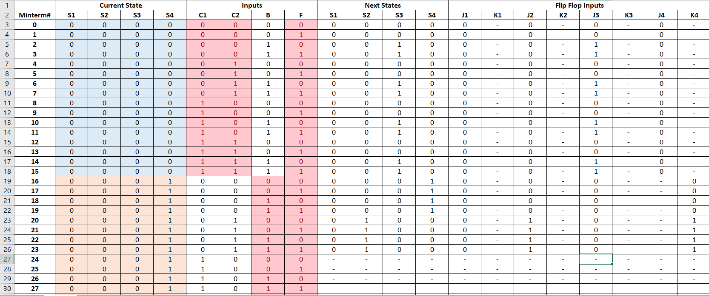
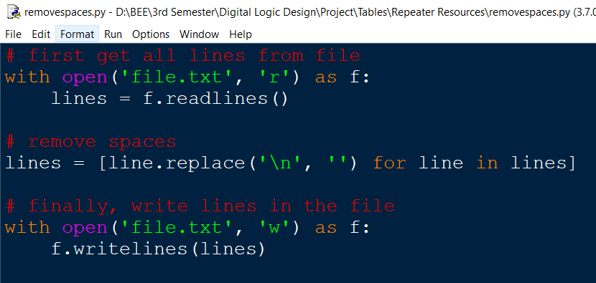
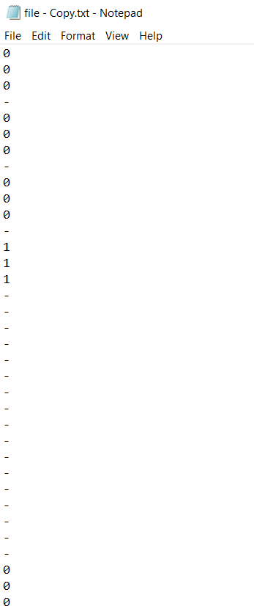

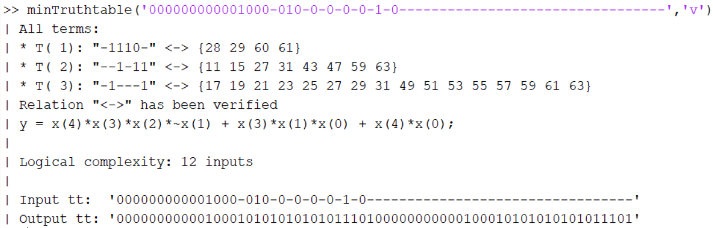
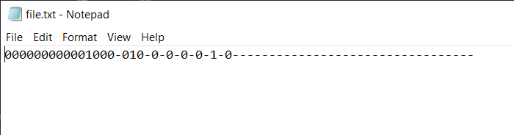
Tables and Simplification:
Before moving forward, a note on the method used for Boolean simplification:
MS-Excel for Tables.
Columns copied to txt files.
A python script to remove spaces.
A MATLAB function for simplification.
Rewriting the equations in terms of our variables.

Slide 9
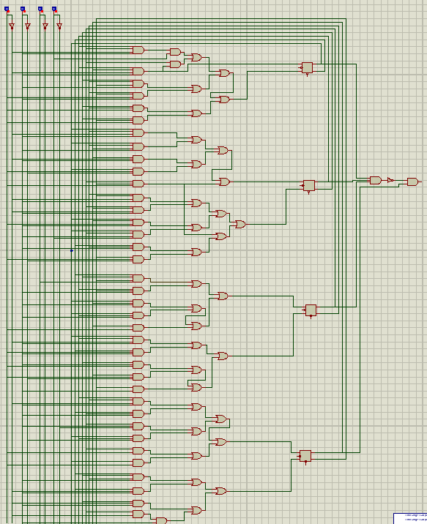
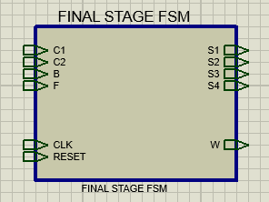
Final Stage FSM-Simulation:
A schematic was drawn up on Proteus.
The circuit proved to be a large one, as could be expected from the 256-row state table.
The small output circuit is the signal going to the solenoid valve.
The circuit was enclosed in a sub-circuit block.

Slide 10
The Repeater:
The circuit in charge of controlling the repetition of certain steps.
A small combinational block would first take the state of the Final Stage FSM(4-bits) and convert it into a 2-bit code telling the succeeding FSM if and how many times a step is to be repeated.
The state diagram is shown here. Remaining work was same as before.

Slide 11
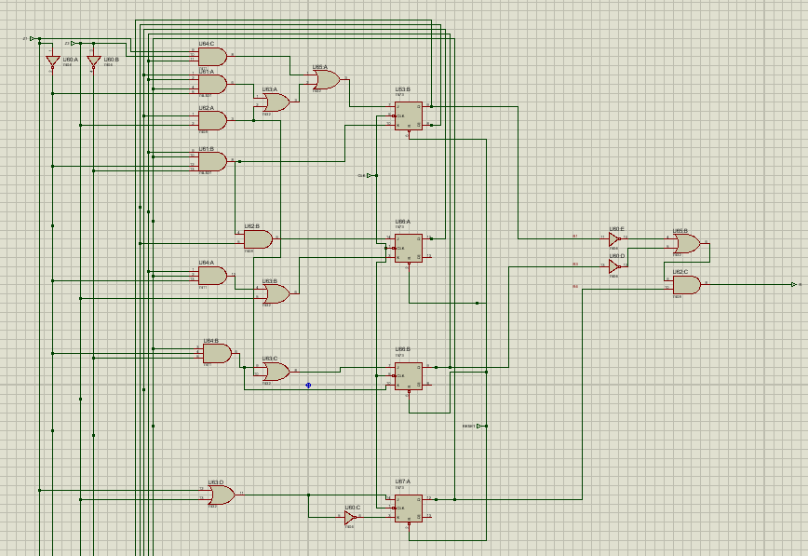
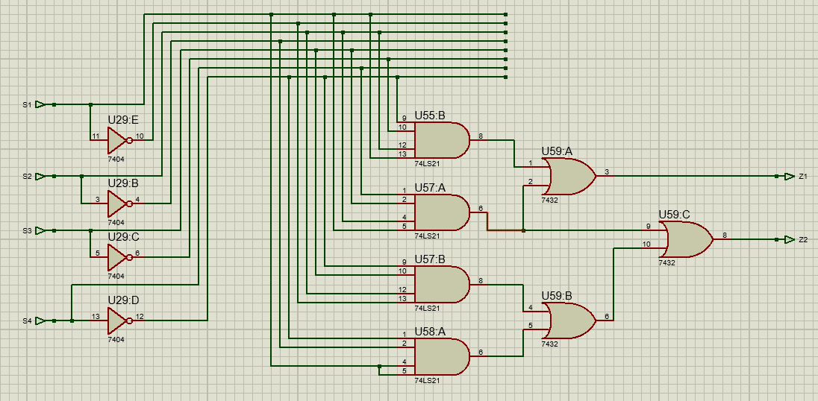
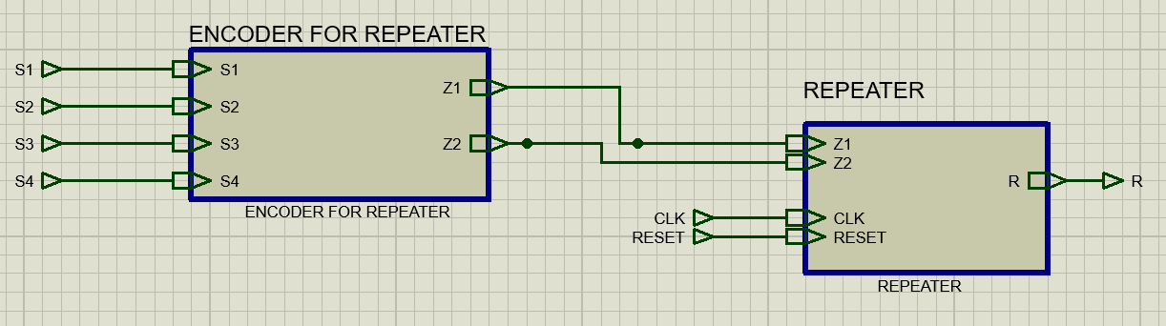
The Repeater- Simulation:
The repeater and its companion combinational circuit were both drawn on Proteus.

Slide 12
The Time Controller:
This circuit must signal if the time for the current step is up.
For this circuit, an attempt was made to employ creativity and move away from the redundant FSM approach by using an algorithmic and building-block approach.

Slide 13
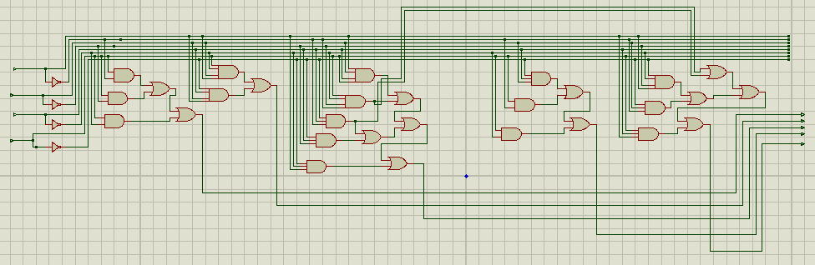
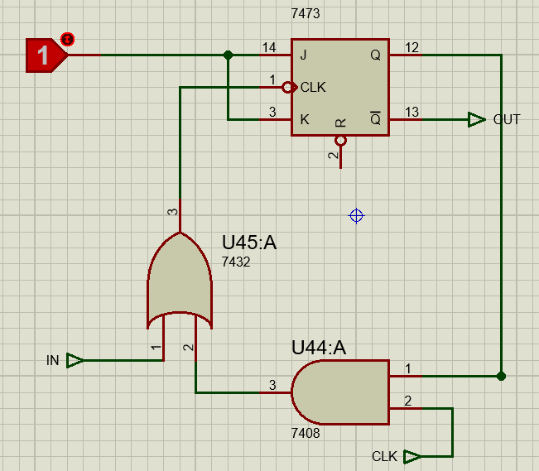
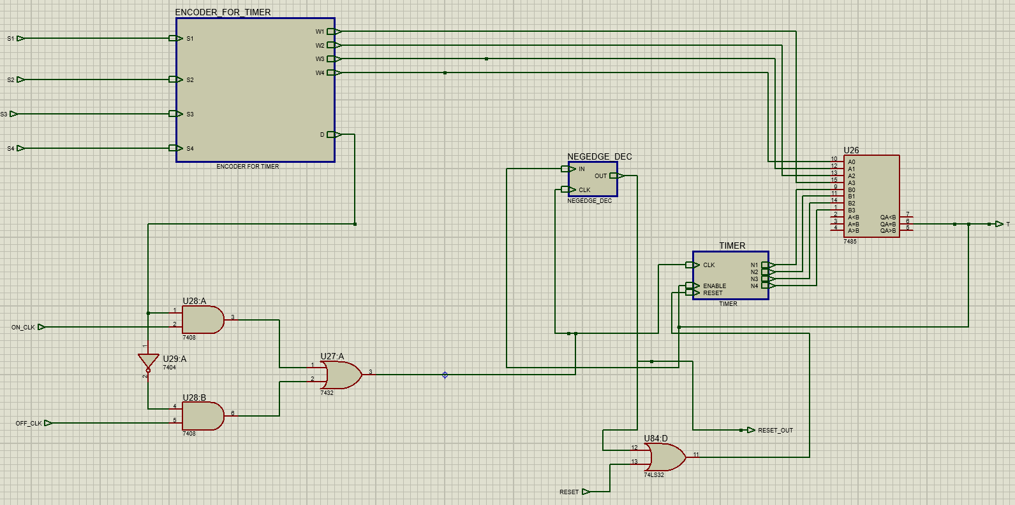
The Time Controller-Simulation:
The time controller was similarly drawn on proteus.

Slide 14
Clock Multipliers:
Two of these circuits are to be made – one for the speed control and one for the quantity control.
The base clock period was decided to be 0.1s (10Hz). This circuit had to multiply that by 8, 10, or 15 (0.8s, 1s or 1.5s) based on user input.
This circuit was again perceived as an FSM.

Slide 15
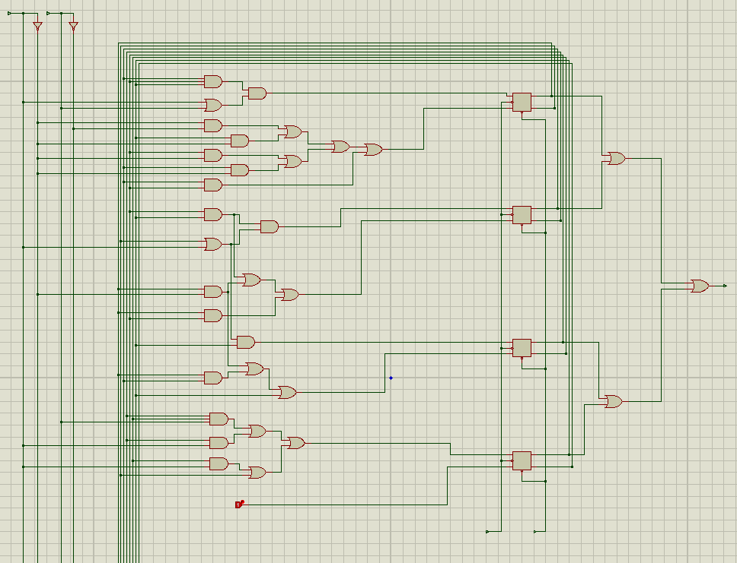
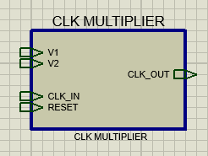
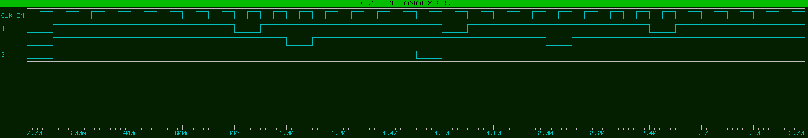
Clock Multiplier-Simulation:
The schematics as well as the timing diagrams are shown below:

Slide 16
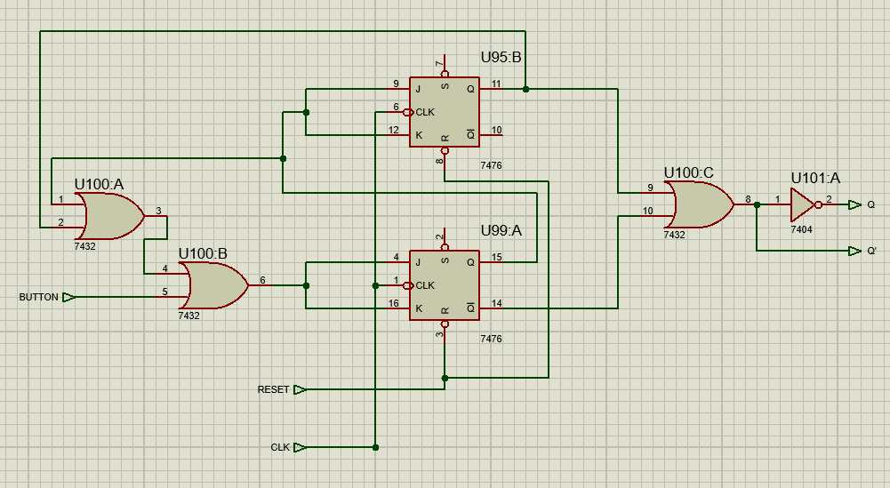
A Problem-User Input:
A problem arose when the back button feature was being tested. The button-press was being counted multiple times.
This is because the clock frequency is 10Hz, and even the quickest press of a button is guaranteed to last for more than 0.1s.
The solution was one last FSM, one that ensures that user input is processed only once:

Slide 17
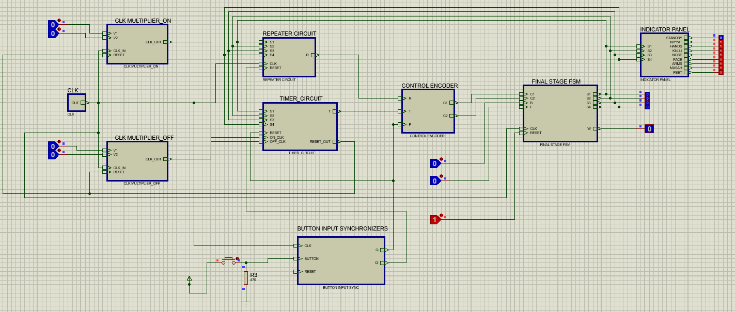
Everything Put Together:

Slide 18
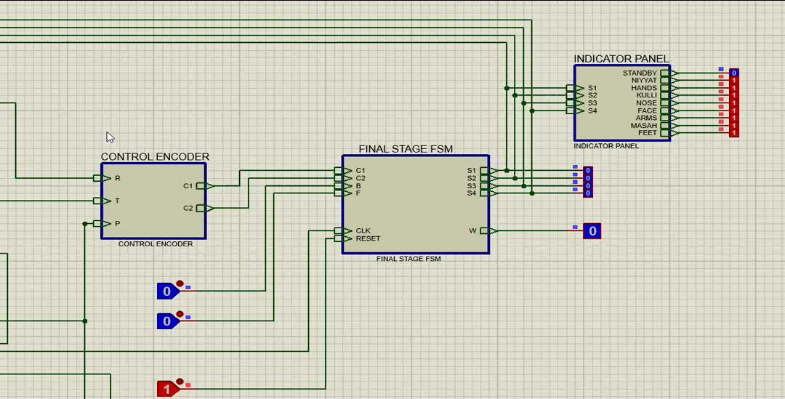
Runs As Expected!

Slide 19
Conclusions:
The design and simulation of the project was a very educational experience; a lot was learnt.
The final product matched the initial block diagram almost completely, thus we can declare our design a success.
However, the design as it stands now is not implementation friendly.
A multiplexer implementation would be easier in theory, but would still require micromanaging of at least hundreds of input lines.
A programmable-memory implementation is more feasible, so is an FPGA one. Both unfortunately, fall well out of scope at the moment.
We stand by our initial pitch; the device is a practical and useful one. Can be very useful if implemented in a suitable package.
The idea can be further expanded into one of a smart bathroom system, in which one can record macros based on their everyday usage. It is easy to imagine such systems in the smart homes of tomorrow.

Slide 20
THANK YOU

